Slide 1
ACCELER
YETTEL SERBIA · M365 COPILOT LEADERSHIP WORKSHOP
Build your
AI team.
Three agents. Your own working week. Ninety minutes.
Notes:
OPEN (40 sec). They have just come out of hours of AI-strategy + AIQ
theory with Anshuman. Say it in the first sentence: "You have had the
theory this morning. We are not doing more theory. In the next ninety
minutes you will each build a small AI team — on your own account."
"Build your AI team" is the mental model. Not a chatbot. Not a feature.
Three colleagues, each with a job, each trained by you.
Tone: warm, fast, confident. The screen is always cast — let it carry.

Slide 2
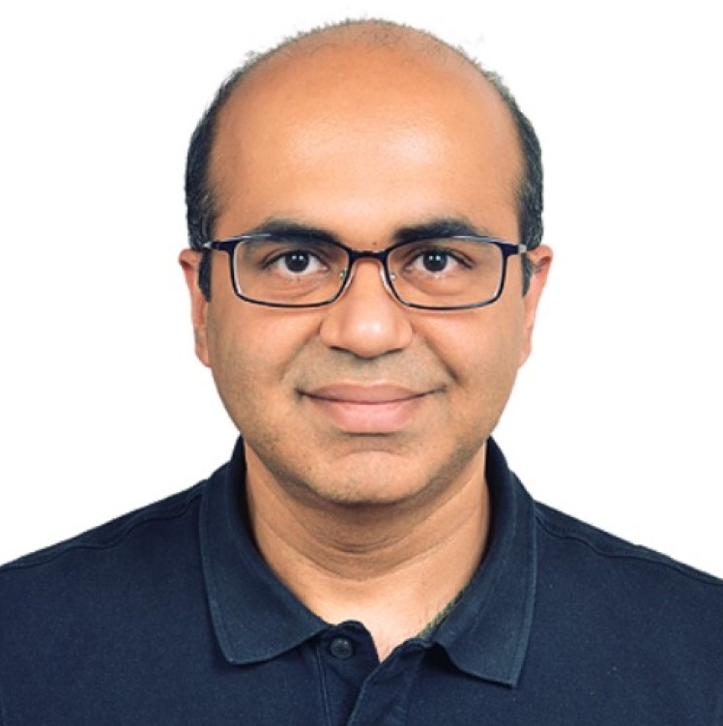
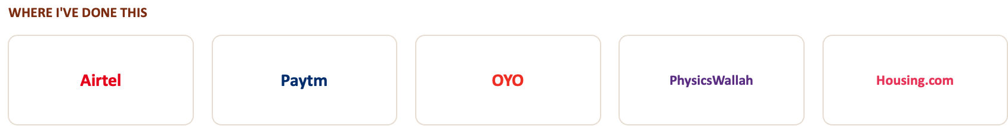
ACCELER
Madan Rawtani
20+ years scaling growth at consumer-internet companies
Ran revenue & marketing at Bharti Airtel
Led growth & lifecycle ops at India scale
XLRI MBA. Reforge alumnus. Now: AI deployment for enterprises.
Notes:
● Lead with the telecom credibility: "I ran revenue and marketing for 2 million broadband subscribers at Airtel — churn, retention, the P&L. The world the you lives in is one I've actually operated in."
● Then the breadth in one line: "Growth and lifecycle ops at India scale — Paytm, OYO, Housing, PhysicsWallah."
● Then why you're in THIS room: "And I build AI systems in production — automation and LLM workflows. That's the bridge between what I did and what we're doing today."
● Land it on them, not you: "I'm not here to show you AI in theory. I've sat in the operator's chair. Today we build the agents I wish I'd had."

Slide 3
ACCELER
HOW THE NEXT 90 MINUTES RUN
Three steps. You, in every one.
SET UP
→
BUILD 3 AGENTS
→
SEE ONE RUN
Get everyone
working
On your own
account, live
It works while
you sleep
Notes:
SESSION STRUCTURE (60 sec). Walk the three headlines left to right, one
sentence each. Keep it light — this is a map, not content.
1. SET UP — "First we make sure everyone's environment works. We do this
together, up front, so nothing breaks mid-session."
2. BUILD 3 AGENTS — "Then you build three AI agents yourself. Not me
demoing — you, on your own account."
3. SEE ONE RUN — "Then I show you a fourth agent that runs on its own
schedule and delivers before you even ask."
Then say the fourth thing out loud (it is NOT on the slide, deliberately
— you mention it, no box for it): "And before you leave, we will recap —
what this means for you, and what you take back to your teams Monday.
That is the part that actually matters."
Land the framing and pause on it: "The building is the surface activity.
It takes minutes. The thinking underneath — that is what you are here
for. So interrupt me. Ask. This only works if it is a conversation."
This sets the expectation that the room talks. Mean it.

Slide 4
ACCELER
THREE HOUSE RULES
This works best as a conversation.
01
Ask, any time
02
Stuck? Pls ask
03
Be Marko, not a spectator
Notes:
HOUSE RULES (60 sec). Three labels on screen; you say the rest.
3. BE MARKO, NOT A SPECTATOR — You are building this on your own screen. Try things. Break things."
- "Quick one before we start — who here has actually built anything with
AI, versus used ChatGPT a few times? Honest hands."
Goal: get one human voice into the room in the first five minutes. After
that they stay warm. Online + conservative + 15+ yrs telco + low
prompting fluency — do NOT assume they know prompting; do NOT lecture;
DO pull them in by name, gently, early.

Slide 5
ACCELER
PHASE 1
First, let's get
you set up.
Nobody moves on until everybody is in. Five minutes, well spent.
Notes:
SEPARATOR (15 sec). Full-stop beat. "Before any of the interesting
stuff — we get everyone's environment working. This is the part people
skip and regret. We do not skip it."
Set the rule out loud: "We do not move past setup until everyone is in.
If you are stuck, say so now — not in twenty minutes." Then advance to
the steps.

Slide 6
ACCELER
SETUP · TWO STEPS
Get your VM running.
1
Find your VM details
A VM URL + a user ID and password, in the email from the Operations team.
Not there? Check spam. Still not there? Send your email to Anshuman now — he forwards it immediately.
2
Open the browser, log in
Paste the VM URL into the browser. Sign in with the user ID and password. That is it.
Notes:
SETUP STEPS (run live, up to ~20 min total — do not rush).
STEP 1 — VM details:
"Everyone needs two things: a VM URL, and a user ID + password. They are
in an email from the Operations team. Open your mail and look for it
now."
Then immediately de-risk it: "It often lands in spam — check there. If
you genuinely cannot find it, do not sit quietly: send your email
address to Anshuman right now in the chat, and he forwards yours
straight away." Wait. Watch the room/chat. This is the #1 place people
get stuck — handle it patiently. The morning's download scare is exactly
why setup is up front.
STEP 2 — Log in:
"Open the browser. Paste the VM URL. Sign in with the user ID and
password from that email." Walk it on the cast screen as you say it.
Then the two screenshots on the next slides show exactly what they
should see. Use them to confirm: "Your screen should look like this —
thumbs up in the room, or a yes in chat, when you are in."
Do NOT advance until the room confirms. Name a couple of people if it is
quiet: "X, are you in? Y?"

Slide 7
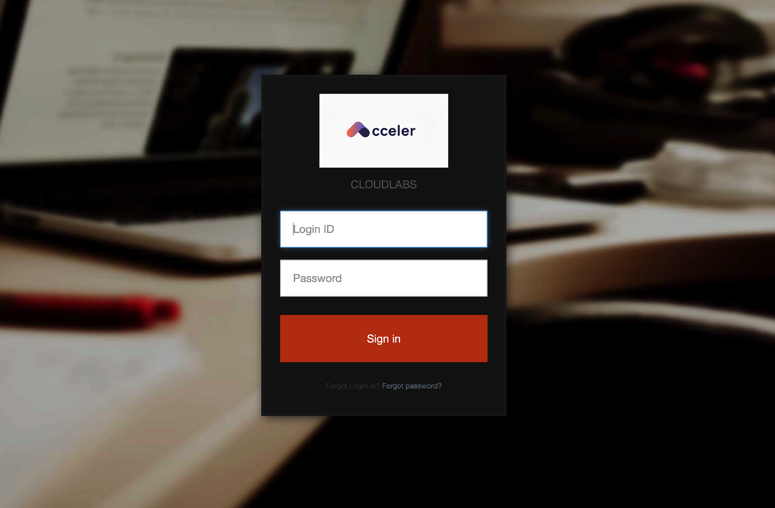
ACCELER
WHAT YOU SHOULD SEE · 1 OF 2
1 | The VM login screen.
Notes:
VM SCREENSHOT 1 (paste image before the session).
Caption while pointing: "This is the login screen you should be on after
pasting the URL. Enter the user ID and password from the Ops email here."
Confirm hands/chat before moving on.

Slide 8
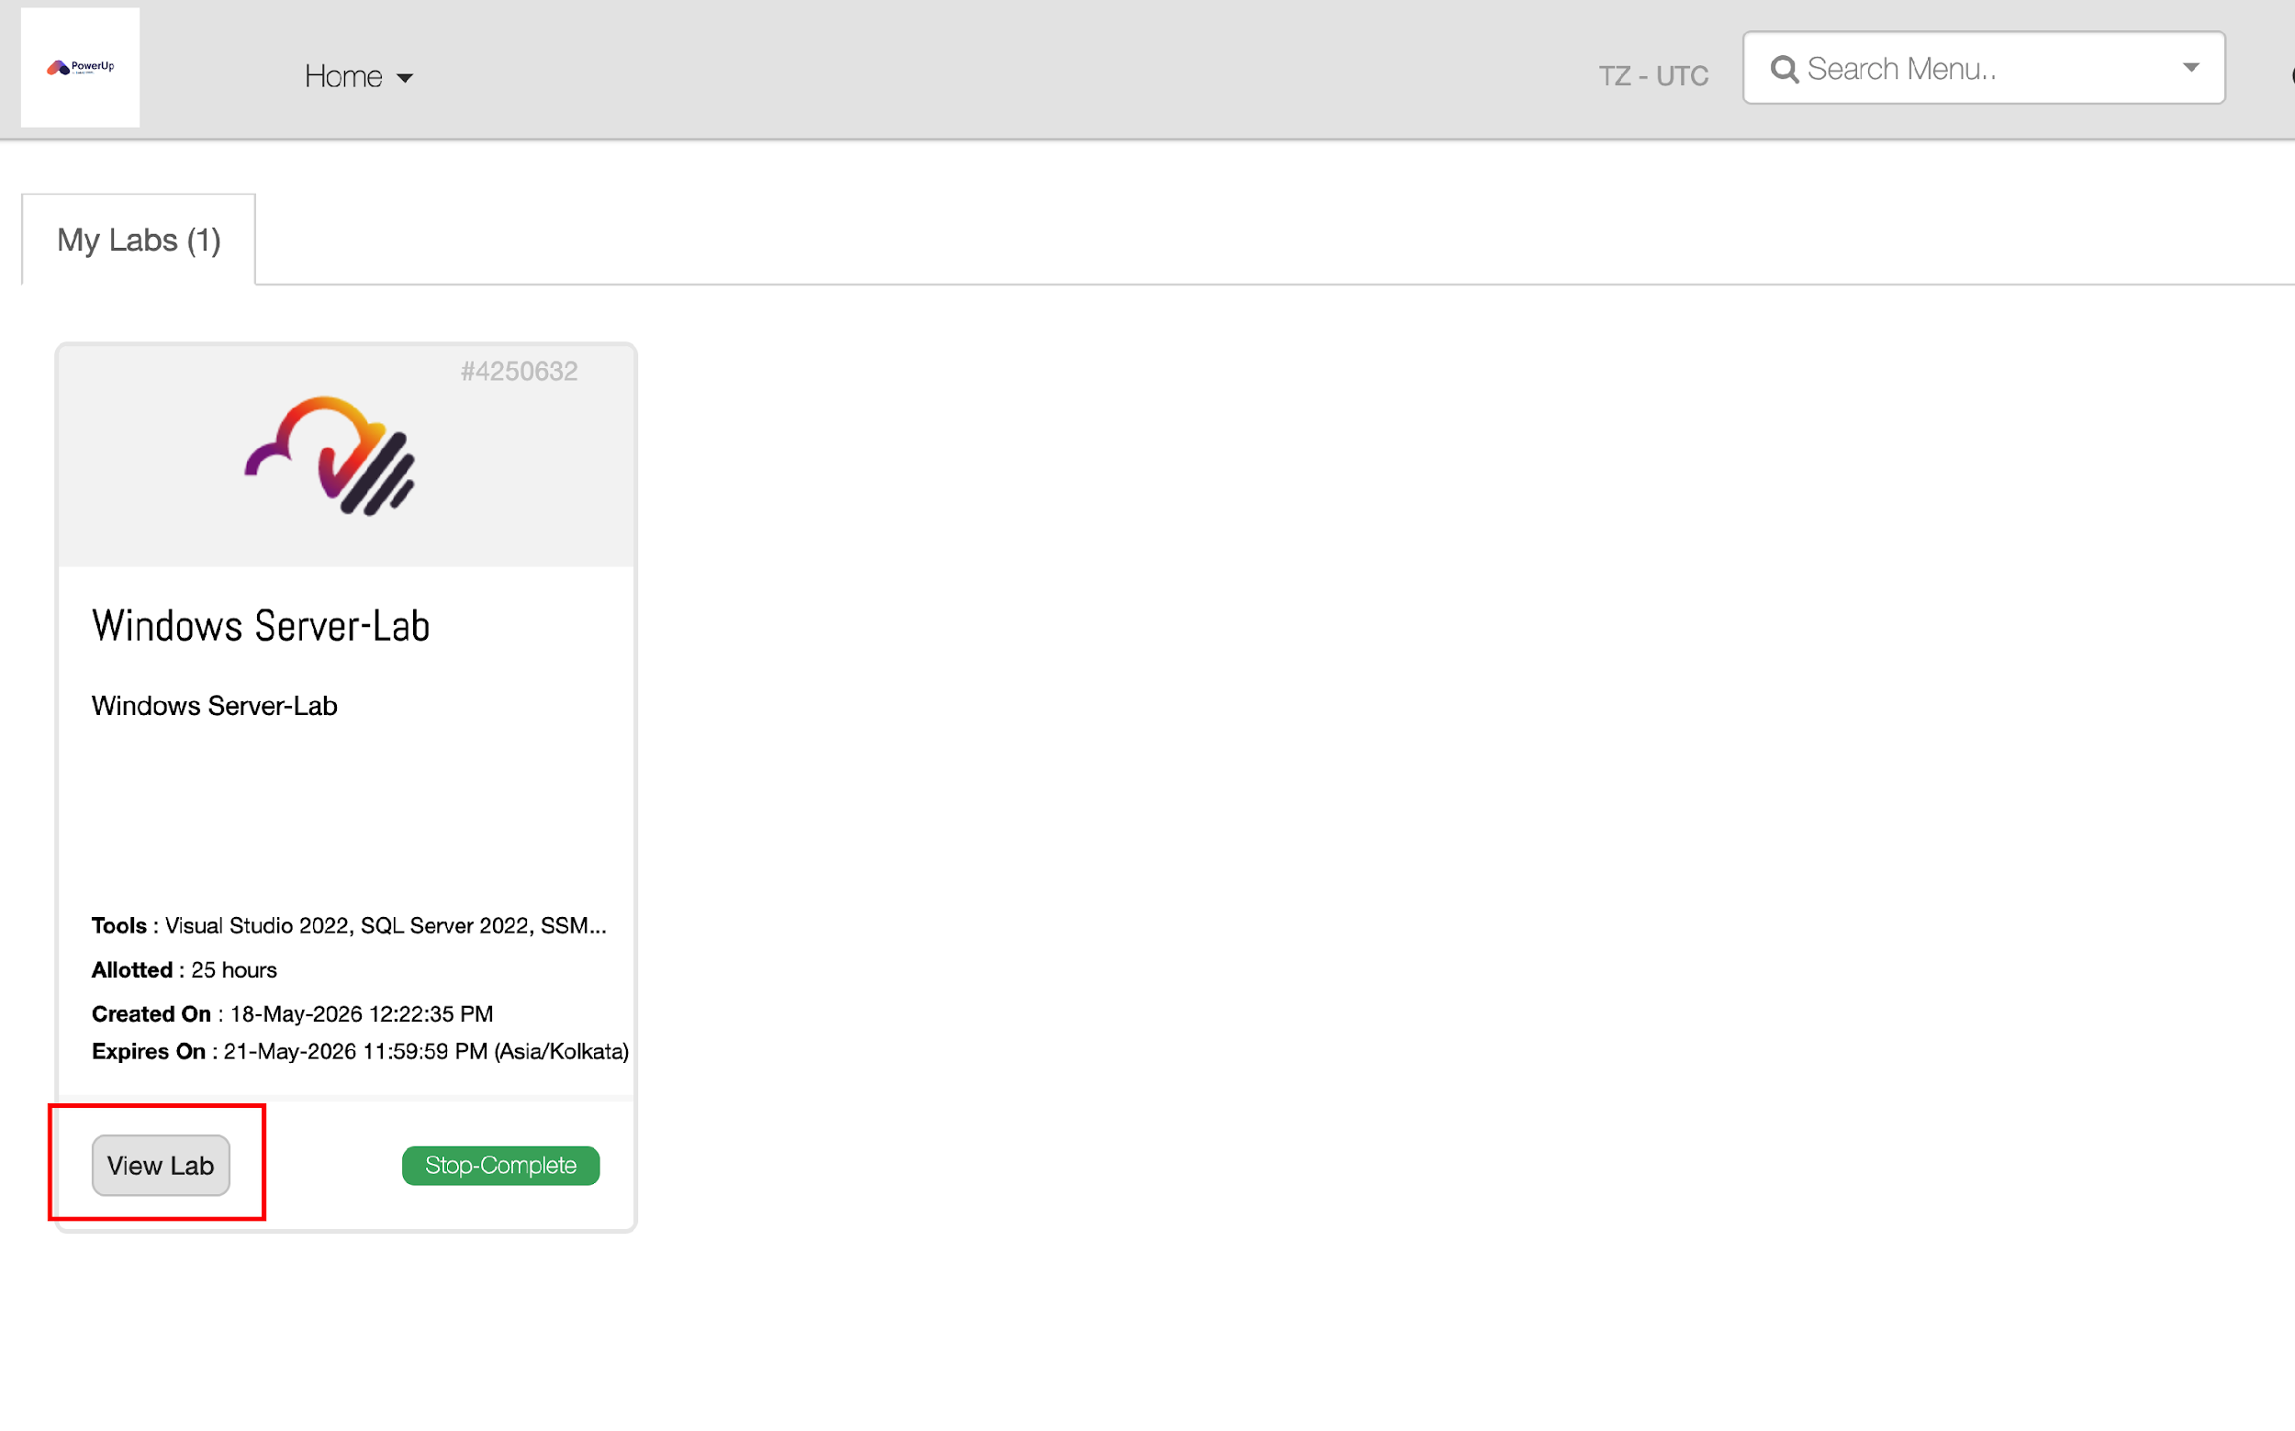
ACCELER
WHAT YOU SHOULD SEE · 1 OF 2
2 | The VM login screen.
Notes:
VM SCREENSHOT 1 (paste image before the session).
Caption while pointing: "This is the login screen you should be on after
pasting the URL. Enter the user ID and password from the Ops email here."
Confirm hands/chat before moving on.

Slide 9
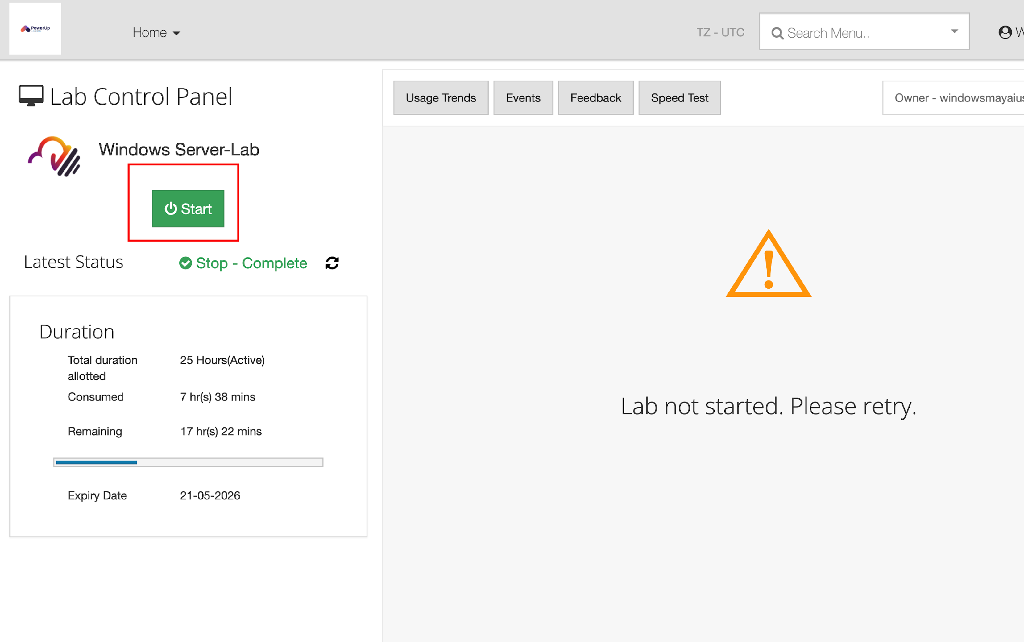
ACCELER
WHAT YOU SHOULD SEE · 1 OF 2
3 | The VM login screen.
Notes:
VM SCREENSHOT 1 (paste image before the session).
Caption while pointing: "This is the login screen you should be on after
pasting the URL. Enter the user ID and password from the Ops email here."
Confirm hands/chat before moving on.

Slide 10
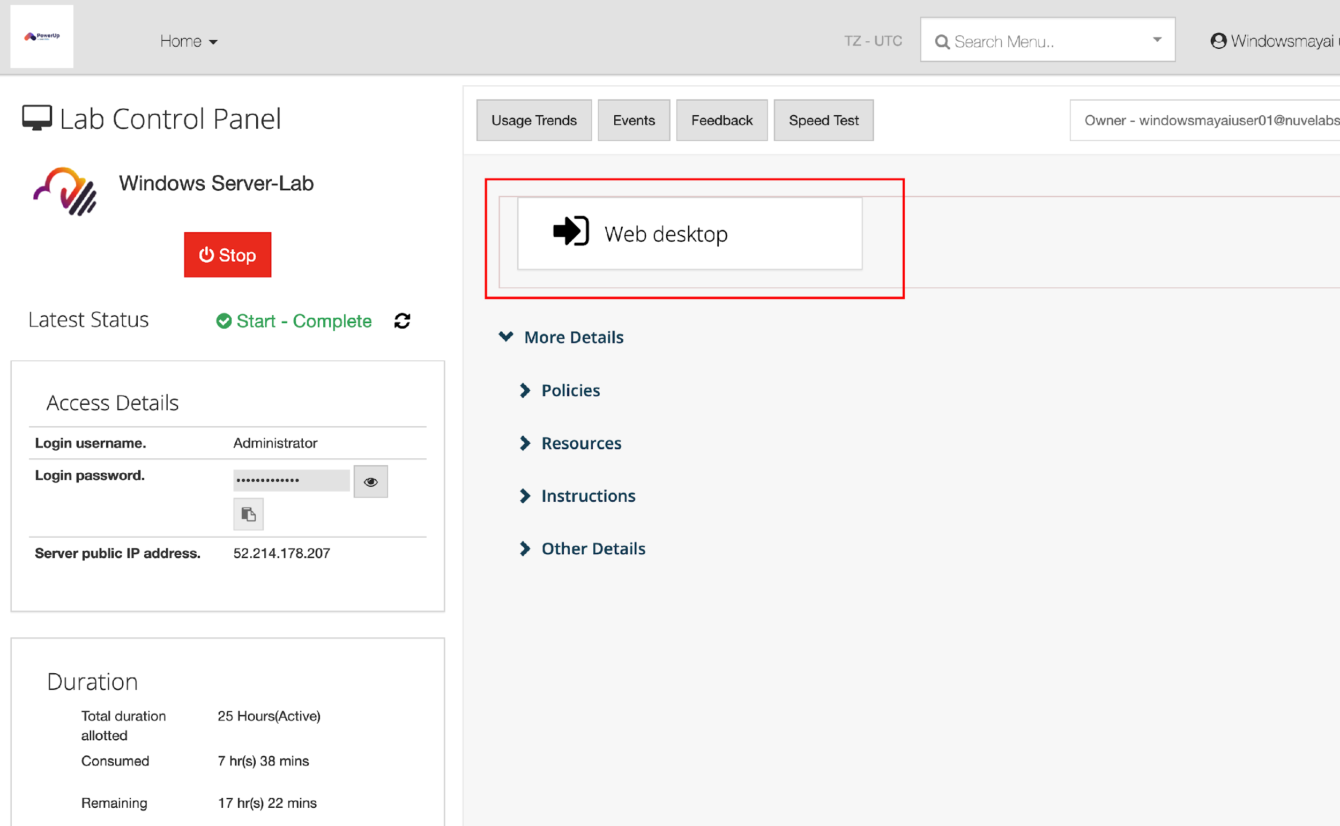
ACCELER
WHAT YOU SHOULD SEE · 1 OF 2
4 | The VM login screen.
Notes:
VM SCREENSHOT 1 (paste image before the session).
Caption while pointing: "This is the login screen you should be on after
pasting the URL. Enter the user ID and password from the Ops email here."
Confirm hands/chat before moving on.

Slide 11
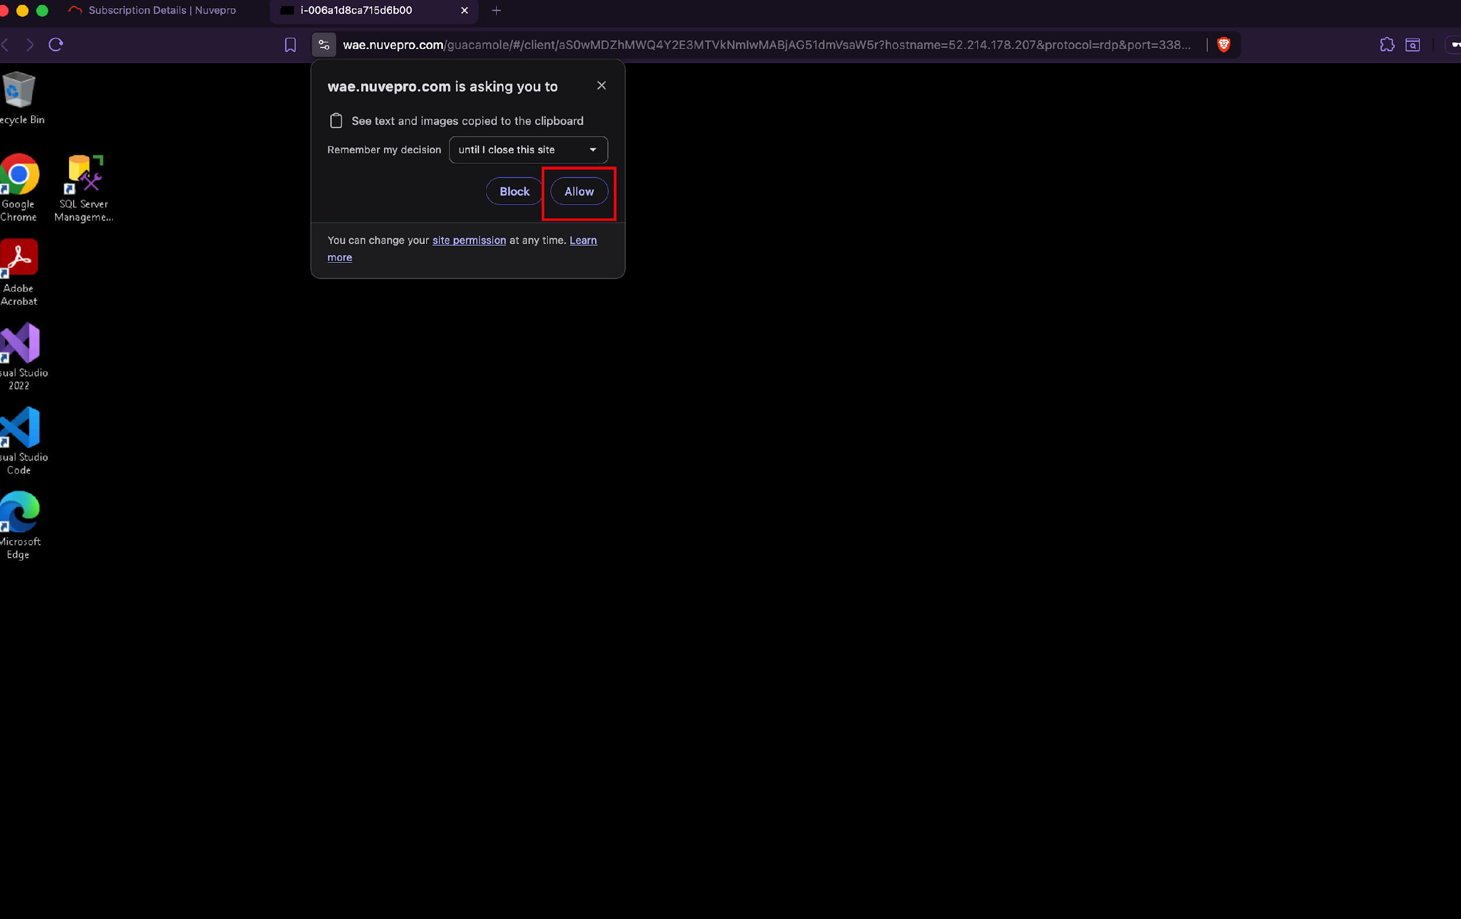
ACCELER
WHAT YOU SHOULD SEE · 2 OF 2
You're on the desktop.
Notes:
VM SCREENSHOT 2 (paste image before the session).
Caption: "Once you are in, you land on a Windows desktop — this. If you
see this, you are set. If you do not, flag it now."
This is the cue to confirm EVERYONE is in before introducing Marko. Do a
final sweep: "Anyone still not on this screen? Last call."

Slide 12
ACCELER
THE SCENARIO
You're staring at a desktop.
Whose is it?
For the next ninety minutes, you are Marko Petrov.
Notes:
SEPARATOR (20 sec). The pivot from setup into the scenario. Slow down.
"You are all looking at a desktop. Inbox, calendar, files. Whose is it?
Not yours. For the next ninety minutes, you are Marko Petrov — and we are
going to build him an AI team." Then advance to the bio.

Slide 13

ACCELER
THE PERSON WHOSE WEEK THIS IS
Marko Petrov
VP, Customer Experience & Commercial Operations
Yettel Serbia · reports to Lena Maric, Chief Commercial Officer
Back-to-back meetings. A fast inbox. Busy Teams channels
ON HIS PLATE THIS WEEK
MTS cut family
bundles 18%
Niš network
still broken
Government B2B
tender, Friday
Q2 plan due,
half-written
Notes:
MEET MARKO (90 sec). They have read the pre-read; this is the recap and
the moment to make them connect it to themselves.
Read the profile at pace — names matter, Lena Maric (his boss) comes back
in the Meeting Prep build.
INTERACTIVITY (do this — exactly the kind of beat the session needs):
before reading the four priorities, ask the room: "Look at Marko's week.
A competitor just attacked on price. A network problem that will not die.
A tender deadline. A plan due to your boss. Honestly — how different is
that from YOUR week?" Pause. Take one or two answers; online, call a name
warmly: "X, does that look like your Monday?" The point lands harder from
their mouth than yours.
Then the four chips, 5 seconds each. These four threads are exactly what
the agents surface later — name them now so the output has meaning
instead of being text on a screen.
Marko is a STRUCTURED person — say this, it sets up the next slide: he
writes things down, he keeps his priorities and brand guidance
documented. That discipline is why an agent can actually help him.

Slide 14
ACCELER
NOW — LOOK AT MARKO'S WORLD
1. Open Edge
2. First shortcut: Microsoft 365.
3. Next Steps :
01 INBOX
02 CALENDAR
03 ONEDRIVE
Real threads. Pricing,
a tender, the network.
Two full weeks,
already populated.
His brand guidelines
and his priorities.
Notes:
MARKO'S M365 (90 sec). Switch to the cast screen and walk it live —
the slide is just the map. Script:
"Open Microsoft Edge. You will see shortcuts. Click the first one —
Microsoft 365."
INBOX: open it. "This is Marko's inbox. Look — it is not empty. Real
threads: the MTS pricing move, the government tender, the Niš network
problem, his boss asking for things. This is a real working week."
(Data reality, say it lightly so it never derails later: "Some mails say
'[Draft] sent' or 'Undeliverable' — that is just how we populated this
through Microsoft's API. Ignore the labels; the content is what matters.
Teams is quiet on purpose — you will see why that is a good thing.")
CALENDAR: "Two full weeks, populated. Meetings he has to walk into,
including a 1:1 with Lena."
ONEDRIVE: "And his OneDrive — Marko is a structured person. He has
written down his brand guidelines and his priorities. That documentation
is exactly what makes an agent able to work for him."
Land the bottom line: "This is the whole idea. An agent is only as good
as what it can read. So we gave it a real world to read." Then advance to
the build separator.

Slide 15
ACCELER
PHASE 2
Now we build Marko
an AI team.
Three agents. Each one takes a part of his job off his plate.
Notes:
SEPARATOR + AGENT BACKGROUND (60 sec). Before the first build, frame
how to THINK about these agents — keep it short, do not re-teach the
theory they had this morning.
"Three agents. Think of each one not as a tool, but as a colleague you
hire and train once. Marko's market analyst. Marko's meeting-prep person.
Marko's catch-up person. The first ten minutes you spend telling each one
how Marko works is the whole value — same as onboarding a new chief of
staff."
"We build them in order, in the doc in front of you. I will pull these
slides back for a minute between each one to step back. The building
happens in the Companion — let's open it."
[HANDS OFF TO THE COMPANION HERE. The rest of the deck — the per-agent
framing / 'while it runs' narration / recaps / autonomous demo / cascade
/ close — is the v2 back half, unchanged. This v3 file is the FRONT
alignment pass only.]

Slide 16
ACCELER
BEFORE WE BUILD — WHAT KEEPS LANDING ON MARKO'S PLATE
Three recurring problems. Three agents.
STAYING CURRENT
WALKING IN COLD
FALLING BEHIND
↓
↓
↓
Yettel
Market Pulse
Yettel
Meeting Prep
Yettel
Catch-Up
Notes:
PROBLEM -> AGENT (90 sec). Do NOT jump to "here are three agents". Frame
the PROBLEM first, then reveal the agent as the answer. Walk each column
top (problem) to bottom (agent).
1. STAYING CURRENT -> YETTEL MARKET PULSE
"Every week, Marko has to know what just moved in the Serbian market
before a leadership meeting — competitor pricing, the regulator, the
press. Today that means twenty browser tabs and still feeling behind.
That is a recurring, repetitive job. The agent that takes it: Market
Pulse."
2. WALKING IN COLD -> YETTEL MEETING PREP
"Ten minutes before every meeting, Marko needs to know who is in the
room, what was last said, what is open. He preps in the corridor. That
is repetitive. The agent that takes it: Meeting Prep."
3. FALLING BEHIND -> YETTEL CATCH-UP
"Things he has been away from — the Niš problem, a thread that went
quiet — pile up until they reach his desk. He scrambles to catch up
before the next conversation. Repetitive. The agent that takes it:
Catch-Up."
Anchor the principle: "Notice — we did not start with the tool. We
started with the repetitive thing the tool removes. That is how you
decide what to build: find the job you keep doing badly because nobody
has time to do it well."
NOTE: there is a fourth, production-grade autonomous agent. We are NOT
covering it today by decision — do not mention it here.

Slide 17
ACCELER
HOW THE AGENTS UNDERSTAND MARKO'S WORLD
Five files. The context we give them.
01
02
03
04
05
Competitor Pricing
Strategic Priorities
RATEL Bulletin
Q1 Commercial Review
Brand Voice Notes
MTS, A1, Globaltel
tariffs & moves
Marko's 2026 plan
& risk register
What the Serbian
regulator just did
Last quarter
vs plan
How Yettel
sounds
Notes:
THE FIVE CONTEXT FILES (90 sec). The slide shows ONLY the five file
names + a one-line hint. Everything operational goes here, in notes —
NOT on screen.
DO THIS LIVE: switch to the cast screen and open the shared OneDrive
folder. Show the five actual files sitting there. "These five files are
Marko's world. They live in a shared folder every one of you can see —
open OneDrive on your screen, you have them too."
Walk the five by name (point at each file):
- Competitor Pricing — current MTS, A1, Globaltel tariffs and promos.
- Strategic Priorities — Marko's six 2026 priorities and risk register
(this is the file that tells an agent WHY something matters).
- RATEL Bulletin — the Serbian regulator's recent positions.
- Q1 Commercial Review — last quarter's performance vs plan
(the "what changed since last time" file).
- Brand Voice Notes — how Yettel sounds; words to use and avoid.
CRITICAL — speaker notes only, do NOT put on screen and do NOT say it as
a rule up front: each agent gets only the 2-3 files relevant to its job
(Market Pulse: 01 + 03; Meeting Prep: 02 + 05; Catch-Up: 02 + 04 + 05).
You will show this naturally when you build each agent. The teaching
point lands better in the build than as an abstract rule here. If asked
"does every agent read all five?": "No — and that is the discipline.
Loading the wrong files makes an agent noisier, not smarter. You will
see me give each agent only what it needs."
Anchor: "An agent is only as good as what it can read. Files are the
lens. Give it the wrong lens and the answer blurs."

Slide 18
ACCELER
PHASE 2 · WE BUILD
Open the Companion.
Everything we build from here is in the doc in front of you. We build it together, one agent at a time.
Notes:
OPEN THE COMPANION (30 sec on the slide; then the whole build runs
from the doc + these notes).
Say: "From here we stop looking at slides and start building. Open the
Workshop Companion — it is one of your tabs. Everything for each agent
is in there: the name, the description, the instructions, the toggles.
We build it together, on screen, one agent at a time. I will not bring
slides back — from here the doc is the script and I will talk you
through every step."
Mechanics (online): you cast your screen, switch your browser tab from
this deck to Copilot + the Companion. Tell them explicitly to follow
the Companion on their own screen as you build on yours.
=== BUILD GUIDANCE — the section the user runs entirely from notes ===
The user omitted a separate "what the agents do" section by choice and
covers it through these notes while building. Cover, in order:
BLOCK 1 — STOCK RESEARCHER (the bar). Run Microsoft's built-in
Researcher on a Yettel market question. It takes 5-7 min — do NOT wait
in silence: narrate the trace (how it searches, picks sources). Truth
bomb: "almost nobody watches this; the thinking is the insight." Point
out: it answered with no Yettel context, never asked for a city/window.
"This is the bar. Now we build one that clears it."
BLOCK 2 — YETTEL MARKET PULSE (first build). Build the six fields from
the Companion. Toggles: web search ON + the 2 files (01 + 03). Test it
deliberately vaguely ("give me a market briefing"). It will REFUSE and
ask for a city + time window — pause and name it: "that refusal is the
whole point; we told it never to run sloppy." Interactive beat: ask the
room "I don't know any Serbian city but Belgrade — how did we even write
this prompt?" Don't rescue them; then reveal Prompt Coach (an LLM writes
the prompt for the LLM). Recap: same question as stock, completely
different answer.
BLOCK 3 — STOCK COPILOT CHAT, THEN MEETING PREP. First run default
Copilot Chat on "prep me for my 1:1 with Lena" — it is competent but
disclaims its own suggestions ("prompts are mine, template"). That gap
is the point. Then build Meeting Prep (files 02 + 05 + Outlook + Teams).
Two-prompt pattern: first a calendar-grounded brief; the agent offers
to scan email/Teams; say yes; second response names specifics and gives
an "updated read". Honest gaps: "No Teams activity found" if Teams is
empty — that is good, not a bug.
BLOCK 4 — YETTEL CATCH-UP. Same recipe (files 02 + 04 + 05 +
Outlook/Teams). One prompt: "catch me up on Niš." Same plumbing as
Meeting Prep, different question -> different output. Point at the
"what's stuck" section naming the Ericsson blocker — that is reasoning,
not retrieval. (Flexible: if discussion ran long, demo this instead of
full build.)
DATA REALITIES (pre-empt lightly, do not let them derail a demo):
some emails say "[Draft] sent" or "Undeliverable" — artefacts of how we
populated the inbox via Microsoft's API; ignore the labels. Teams is
intentionally quiet — that is why "No Teams activity found" is honest,
not broken.
CLOSE (verbal, no slide): recap the three agents by name; name the
lessons (asks before it runs / reads your real world / stock vs yours /
a conversation / honest gaps); land the cascade — what you do Monday on
your own account, what you ask your tech teams, what you change for your
non-tech teams. If asked about pricing/next steps: stay neutral, take
it offline.

Slide 19
ACCELER
COMPANION V7 · HOW TO READ IT
We build in the doc. Six blocks. Every block has the same shape.
• Tell the room: slides stop here. From now we are IN the tool. The Companion in front of them is the build guide.
• Every block reads the same way once they've done one:
THE SHAPE OF EVERY BLOCK
• THE AGENT — what it does, when you'd use it
• BUILD STEPS — the six fields in Agent Builder, in order
• TEST IT — the prompt to paste once it's saved
• WHAT GOOD LOOKS LIKE — how to know it's set up right
THE TOGGLE STRATEGY (SAY IT ONCE, HERE)
• Market Pulse = web search ON + the files. Meeting Prep & Catch-Up = web OFF, your sources only.
• 'Only use specified sources' is the accuracy lever — it stops the agent wandering.
ON THE VM SCREEN
› M365 Copilot is open
› Companion doc open in a 2nd tab
› Create → New agent → Configure (show where it lives)
Notes:
● Slides stop here — from now we're live in the tool; the Companion is their build guide
● Six blocks, every block reads the same way once you've built one
● Walk the 4-part shape: The Agent / Build Steps / Test It / What Good Looks Like
● Say the toggle rule ONCE, here: Market Pulse = web ON + files; Meeting Prep & Catch-Up = web OFF, sources only
● ASK: "Who has actually opened Agent Builder before today?" (hands — calibrate pace)
──────── detail / context ────────
THE HAND-OFF: this comes straight off slide 17 "Open the Companion".
DO (on the VM)
• M365 Copilot open. Companion open in a 2nd browser tab.
• Show Create → New agent → Configure so they see where every build starts.
WHY THE ASK: mixed-fluency room — assume most have NOT used Agent Builder.
Pace accordingly.
WATCH
• Do NOT teach prompt engineering yet — it lands naturally in Block 2.
• "Why not just use ChatGPT?" → park it: "That's exactly what Block 1 answers. 90 seconds."

Slide 20
ACCELER
BLOCK 1 · STOCK RESEARCHER (IN-BUILT)
First, feel what generic gives you. No build here.
• Frame WHY before you click: 'This is Microsoft's stock Researcher. We're not building anything. The point is to feel what generic returns — so the difference is obvious when we build the custom one.'
DO THIS LIVE
• Sidebar → Agents → Researcher → fresh chat. Model picker on Auto.
• Paste: 'What is happening in the Serbian mobile market right now?'
WHILE IT RUNS — NARRATE
• It will be coherent and well-cited. That IS good for generic.
THEN LAND THE FOUR GAPS
• Doesn't know who Yettel is (just 'one of three operators')
• Doesn't frame through Yettel's priorities
• Doesn't say what it means for YOU
• Didn't ask you anything — just produced a country-level answer
ON THE VM SCREEN
› Agents → Researcher
› Fresh chat, model = Auto
› Paste the Serbian-market prompt
› Let the citations stream
Notes:
● Frame BEFORE clicking: "We start building — but the FIRST one is a stock agent we don't build. Why? So you feel generic vs custom, and see how we nudge a custom agent."
● Run it live: Agents → Researcher → fresh chat → Serbian-market prompt; narrate the citations ("this IS good for generic")
● ASK while it runs: "What's it NOT going to know about us?" (let them answer — primes the gaps)
● Land the 4 gaps: doesn't know Yettel · doesn't use our priorities · doesn't tell YOU what to do · didn't ASK anything
● Truth-bomb: "Stock is competent but generic. Custom is how teams stop sounding the same." This is the BAR.
──────── detail / context ────────
BLOCK 1 · STOCK RESEARCHER · ~5 min · NO BUILD
THE FRAME LINE (verbatim, this is the one you asked for):
"We now start building. But the very first one is a STOCK agent — one
that already ships in Copilot. We're not building it. Why? So you can
feel the difference between generic and custom — and see how we nudge a
custom agent's behaviour. You need the baseline in your body first."
DO: Sidebar → Agents → Researcher. FRESH chat. Model = Auto. Paste:
"What is happening in the Serbian mobile market right now?"
WATCH: don't over-dwell. The next four agents clear this bar — move on.

Slide 21
ACCELER
BLOCK 1 · BEFORE WE MOVE ON
What you just felt — the baseline.
• Three lines to land, then move:
SAY THESE
• Stock AI is competent. It is just generic.
• A Yettel question deserves a Yettel-grounded answer.
• This is the bar. The next four agents clear it.
• Bridge: 'Now we build the one that knows who Yettel is — Yettel Market Pulse.'
Notes:
● "Stock is competent — but generic."
● "A Yettel question deserves a Yettel answer."
● "That's the bar. Watch the next agent clear it."
● BRIDGE: "Now we build the one that knows who Yettel is — Market Pulse." → slide 21
──────── detail / context ────────
BLOCK 1 RECAP · ~30 sec · mirrors the Companion's orange box.
WATCH: this is a 30-second pivot, NOT a discussion. Teaching happens in
the build, not the recap. Say the three beats, bridge, move.

Slide 22
ACCELER
BLOCK 2 · YETTEL MARKET PULSE
Five-minute market briefing, framed for Yettel. First custom build.
• Frame: 'You tell it a city and a time window — Belgrade, last 30 days — and it briefs you on what just moved, through OUR priorities.'
BUILD THE SIX FIELDS TOGETHER (THEY FOLLOW IN THE DOC)
• 1 Name · 2 Description · 3 Instructions (paste the whole block — don't read it aloud)
• 4 Knowledge: upload only files 01 + 02 (not all five)
• 5 Toggles: Search all websites ON · Only specified sources OFF · Outlook OFF · Teams OFF
• 6 Starter prompts: add all four
THE ONE THING TO CALL OUT IN THE INSTRUCTIONS
• The 'CRITICAL BEHAVIOUR' block: two modes — if scope OR time-window missing, it MUST stop and ask. 'The discipline of asking IS the value.'
ON THE VM SCREEN
› Create → New agent → Configure
› Paste Name / Description
› Paste the full Instructions block
› Upload 01_Competitor_Pricing + 02_Strategic_Priorities
› Set the 4 toggles
› Add 4 starter prompts → Create
Notes:
● Frame: "The one that knows Yettel. Give it a city + time window → 5-min briefing on what moved, through our priorities."
● Build field by field, on screen, wait for the room: "Tell me when your screen matches mine"
● Instructions: paste WHOLE block, do NOT read aloud — but point at CRITICAL BEHAVIOUR (2 modes: no scope/time → it must STOP and ASK)
● Knowledge: upload ONLY 01 + 02 (not all five) — "each agent gets the lens it needs"
● Toggles: web ON · specified-sources OFF · Outlook OFF · Teams OFF — say WHY (web + files = current AND grounded)
● ASK (don't rescue): "Who could've written that instruction block from scratch?" → silence → reveal: an LLM wrote it; the Prompt Coach does this; you're not expected to be a prompt engineer
● Truth-bomb: "Good agents ask before they run. Scoping is leadership applied to AI."
──────── detail / context ────────
BLOCK 2 BUILD · ~8-10 min · FIRST custom agent — go slower, the rest rhyme.
THE "MAKE THEM UNCOMFORTABLE" BEAT (key — do it right):
After Instructions are pasted, ask who could have written that block.
LET THE SILENCE SIT. Do not fill it. Then: "Neither did I. An LLM wrote
that prompt — for the LLM. There's a built-in Prompt Coach that does
exactly this. You describe what you want in plain words; it writes the
block. You are NOT expected to be a prompt engineer."
ORDER ON THE VM: Create → Configure → Name → Description → Instructions
→ point at CRITICAL BEHAVIOUR → upload 01+02 → 4 toggles → 4 starter
prompts → Create.
WATCH: the TOGGLES are the highest-error step. If the room is slow,
stop and screen-share the exact toggle state. Don't move until screens
match.

Slide 23
ACCELER
BLOCK 2 · TEST IT — AND EXPLORE THE EDGES
This is the teaching window. Push the agent's boundaries live.
THE TEST (TWO PROMPTS)
• Fresh chat. Paste vague: 'Give me a market briefing.' → it MUST refuse and ask for two parameters.
• Then: 'Belgrade, last 30 days.' → now it searches and returns the 4-section structure.
VERIFY OUT LOUD
• It asked for params (didn't just run) · cites live web, not just files · 'what it means' bullets cite priorities by number · uses 'we'/'our' · admits thin signal honestly
NOW EXPLORE THE BOUNDARY — THIS IS THE INTERMEDIATE-ROOM GOLD
• Watch the keywords: they come from OUR docs, then it takes that to the web. 'Context narrows the search — that's the point.'
• Re-run with a sentiment angle → it starts pulling Reddit, app-store reviews, social. Say: 'I didn't know it had Reddit access either. One agent could just monitor Reddit.'
• Note the honest caveat live: some sources (Reddit) may block a VM/un-logged-in session — that's the agent being honest, not broken.
ON THE VM SCREEN
› Fresh chat
› Paste 'Give me a market briefing.'
› It refuses → paste 'Belgrade, last 30 days.'
› Re-run with: '…customer sentiment angle'
› Watch it reach Reddit / app reviews / social
Notes:
● Test 1 — paste vague "Give me a market briefing." → it REFUSES, asks for 2 params ("even when I don't tell it to")
● Test 2 — "Belgrade, last 30 days." → now it searches; verify the 4-section structure + "we/our" + honest thin-signal
● Boundary 1 — point at the search keywords: they came from OUR docs, THEN went to the web ("targeted, not data-data-data")
● Boundary 2 — re-run with sentiment angle → it pulls app-store reviews, then REDDIT. Say: "I didn't know it had Reddit access either — one agent could just be a Reddit monitor"
● Boundary 3 — honest caveat (say lightly): a source like Reddit may block a locked-down VM / un-logged-in session — "that's the agent being HONEST, not broken"
● ASK while it runs (5-7 min): "What would YOU want this to scan for your part of the business? Shout the source."
● Truth-bombs: "LLMs are smooth talkers — unusual confidence = ran out of context" · "Stock was generic on BOTH worlds; custom fixes both"
──────── detail / context ────────
BLOCK 2 TEST + BOUNDARY EXPLORATION · ~8-12 min · THE teaching window
you asked for. The 5-7 min runtime IS the lesson — not dead air. This
room is INTERMEDIATE; it rewards being shown the edges.
WHERE THE BOUNDARY MATERIAL COMES FROM: your own live discovery with
Tanmaya (18-May, ~21:57-22:10). The keyword-grounding, the Reddit
access, the app-review pull, the VM-block honesty — all observed, all
real. You're re-running what you already saw work.
THE SENTIMENT RE-RUN PROMPT (verbatim):
"Scan public customer sentiment for Belgrade, last 30 days — app store
reviews, social, complaint sites."
IF ASKED "can it access [X tool]?": good question — explore it live for
~60 sec, this room loves the edges. But TIMEBOX: "We could go forever
here — you've seen the principle, let's move."
BRIDGE: "Before the next build — one more plain stock-chat test, for the
contrast." → slide 23 (recap) then 24.

Slide 24
ACCELER
BLOCK 2 · BEFORE WE MOVE ON
What you just built — Yettel Market Pulse.
SAY THESE THREE
• Good agents ask before they run. Parameters beat assumptions.
• Custom is not a bigger model. It is a tighter lens.
• Five files in our library — only two attached to this agent. Discipline.
• Bridge: 'Next is Meeting Prep. But first — try stock chat one more time, for the contrast.'
Notes:
● "Good agents ask before they run — parameters beat assumptions."
● "Custom isn't a bigger model. It's a tighter lens."
● "Two files, not five. Discipline is the value."
● BRIDGE: "Next is Meeting Prep — but one more stock test first, the other side of generic." → slide 24
──────── detail / context ────────
BLOCK 2 RECAP · ~30-45 sec · tight, NOT a discussion.

Slide 25
ACCELER
BLOCK 3 · TRY STOCK FIRST (DEFAULT COPILOT CHAT)
The other baseline. Stock chat is actually competent here — that's the point.
• Frame: 'In Block 1 stock was blind to the outside world. Now watch it on your INSIDE world — and it's surprisingly good. That makes the lesson sharper.'
DO THIS LIVE
• Open a fresh default Copilot Chat (NOT Researcher, NOT an agent). Work mode.
• Paste: 'Prep me for my 1:1 with Lena tonight.'
WHAT TO POINT AT WHEN IT ANSWERS
• It WILL find the calendar event, pull agenda, suggest a run-of-show. Don't dismiss it — it's good at surface level.
• Now read it closely: talking points are TEMPLATE questions ('what's the status?') — generic to any meeting.
• Note its own disclaimers: 'prompts are mine', 'template is mine'. It's honestly telling you it has no context.
ON THE VM SCREEN
› Default Copilot Chat (work mode)
› NOT Researcher, NOT an agent
› Paste 'Prep me for my 1:1 with Lena tonight.'
› Read the talking points closely
› Point at the 'template is mine' disclaimer
Notes:
● Set the contrast (OPPOSITE of Block 1): "Block 1 = blind to the OUTSIDE world. Now test it on the INSIDE world — and the twist: it's actually pretty good"
● Run live: FRESH default Copilot Chat (not Researcher, not an agent), work mode → "Prep me for my 1:1 with Lena tonight."
● Point at the good: it found the event, pulled agenda, suggested run-of-show — "don't wave this away, at surface level it's useful"
● ASK: "What's wrong with 'what's the current status? what are the top risks?'" → lead them: generic, fits ANY meeting anywhere
● Land it: it ADMITS "prompts are mine / template is mine" — honestly telling you it has no context → scaffolding, not substance
● Truth-bomb: "Stock is generic, custom is yours. Now we build the one that knows Mira's draft and Lena's specific asks."
──────── detail / context ────────
BLOCK 3 STOCK CHAT BASELINE · ~4-5 min · NO build.
WHY THIS MATTERS: it's the inverse of Block 1. There, stock failed on
the outside world. Here, stock is surprisingly competent on the inside
world — which makes the "but it's still generic scaffolding" lesson
land harder. Don't undersell how good it is first.
TIME DISCIPLINE: baseline, not a build. 5 min max → slide 25.

Slide 26
ACCELER
BLOCK 3 · YETTEL MEETING PREP
Ten minutes before a meeting. Works in TWO prompts — that's the craft.
• Frame: 'Marko names a meeting — it tells him who's in the room, what's open, what they'll raise. It reads his Outlook, Teams, calendar AND the Yettel files.'
BUILD (SAME SIX-FIELD RHYTHM)
• 1 Name · 2 Description · 3 Instructions (paste whole block)
• 4 Knowledge: upload 02 + 05; THEN add sources: My emails (Outlook), My Teams chats & meetings
• 5 Toggles: Search all websites OFF · Only specified sources OFF
• 6 Starter prompts: add all four
THE TEACHING POINT — THE TWO MODES + TWO PASSES
• If no meeting named → it MUST ask which meeting. Then PASS 1: calendar-grounded brief. It offers to scan email/Teams. Say yes → PASS 2: the deeper search + an 'updated read'.
• Web is OFF here on purpose — contrast this with Market Pulse out loud.
ON THE VM SCREEN
› Create → New agent → Configure
› Paste Name / Desc / Instructions
› Upload 02 + 05
› Add Outlook + Teams as sources
› Toggles: both web OFF
› 4 starter prompts → Create
Notes:
● Frame: "Marko opens this 10 min before a meeting → who's in the room, what's open, what they'll raise. Reads his Outlook/Teams/calendar + 2 files"
● Delta vs Market Pulse: this one does NOT search the web — say it and explain why ("web is noise for a meeting prep; you toggle per job")
● Build same rhythm: paste Name/Desc/Instructions → upload 02 + 05 → ADD sources: My emails (Outlook), My Teams → toggles both web OFF → 4 prompts → Create
● ASK: "What if Marko just says 'prep me' with no meeting?" → leads to: it must ask (same discipline)
● ASK: "Why two prompts not one perfect prompt?" → leads to the two-pass design
● Explain two passes: Pass 1 = calendar-grounded brief, offers to go deeper → say yes → Pass 2 = email/Teams scan + an "updated read"
● Truth-bomb: "Two prompts beat one perfect prompt. Train it like a chief of staff — once, properly. The 'updated read' is where AI earns its keep."
──────── detail / context ────────
BLOCK 3 BUILD · ~8-10 min · 2nd build, move a bit faster — BUT the
two-pass idea is new; dwell there.
THE DELTA TO CALL OUT LOUD: Market Pulse had web ON because the outside
world was the point. Meeting Prep has web OFF because for a meeting the
live web is noise — what matters is the inbox and calendar. Same tool,
toggled per job. This contrast is the lesson of the block.
IF ASKED about 'emails signed at the bottom' in the Instructions: it's
a real org behaviour the agent is explicitly told to handle (author
signs the body even when the From line differs). Sign of a well-built
agent — good question to validate.

Slide 27
ACCELER
BLOCK 3 · BEFORE WE MOVE ON
What you just built — Yettel Meeting Prep.
SAY THESE THREE
• Agents work in conversations. Two prompts beat one perfect prompt.
• The 'updated read' is where AI earns its keep.
• Train your agent the way you'd train a chief of staff.
• Bridge: 'Last build — Catch-Up. One prompt, structured synthesis across everything.'
Notes:
● "Agents work in conversations — two prompts beat one perfect prompt."
● "The 'updated read' is where AI earns its keep."
● "Train it like a chief of staff."
● (if engaged) "Stock chat was honest about its gaps; custom Meeting Prep doesn't need that — it actually read your emails"
● BRIDGE: "Last build — Catch-Up. One prompt, synthesis across email/Teams/files." → slide 27
──────── detail / context ────────
BLOCK 3 RECAP · ~30-45 sec.

Slide 28
ACCELER
BLOCK 4 · YETTEL CATCH-UP
Get current on a topic in 60 seconds. Same architecture, different question.
• Frame: 'Meeting Prep was about navigating a ROOM. Catch-Up is about understanding a SITUATION — a customer, a project, a thread. One prompt, seven-section read.'
BUILD (THE RHYTHM IS NOW FAMILIAR — MOVE QUICKER)
• 1 Name · 2 Description · 3 Instructions (paste whole block)
• 4 Knowledge: upload 02 + 05; add sources: My emails (Outlook), My Teams chats & meetings
• 5 Toggles: Search all websites OFF · Only specified sources OFF (same as Meeting Prep)
• 6 Starter prompts: add all four
THE TEACHING POINT
• Same sources as Meeting Prep — but asks 'where does this stand?' not 'who's in the room?'. Same engine, different question = different agent.
• Test: 'Catch me up on Nis.' One prompt only — no follow-up step. Verify 7 sections + an honest 'source gaps' note.
ON THE VM SCREEN
› Create → New agent → Configure
› Paste Name / Desc / Instructions
› Upload 02 + 05 · add Outlook + Teams
› Toggles: both web OFF
› 4 starter prompts → Create
› Test: 'Catch me up on Nis.'
Notes:
● Frame the contrast (the KEY idea): "Meeting Prep = navigating a ROOM. Catch-Up = understanding a SITUATION. Same architecture, same sources — different question = different agent. That's the unlock for your teams."
● Build fast, same rhythm: Name/Desc/Instructions → upload 02 + 05 → add Outlook + Teams → toggles both web OFF → 4 prompts → Create
● Test: "Catch me up on Nis." — ONE prompt, no follow-up ("synthesises everything in one pass, unlike Meeting Prep")
● ASK (plants the cascade): "Think of ONE topic on YOUR plate you'd want a 60-sec read on every morning — hold that, we come back to it at the close"
● Verify: 7 sections in order · connects Nis to Priority 5 · names real people (Petar Novak) · ends with honest 'source gaps' note
● Truth-bomb: "Honest gaps build trust — 'no Teams activity found' is a GOOD answer. The agent you reach for Monday when you can't remember where Friday landed."
──────── detail / context ────────
BLOCK 4 BUILD · ~6-8 min · 3rd build, they know the rhythm. Move fast.
The INSIGHT, not the mechanics, is the point: SAME ENGINE, DIFFERENT
QUESTION. Don't re-explain the six fields — just do them while you talk
about the insight.
THE CASCADE PLANT: the "think of one topic on your plate" ask is
deliberate — you collect it at slide 31. Make them actually hold a real
example in their head now.
IF BEHIND ON TIME: this is the fastest build to run (room knows the
fields). Speed here, protect the close (slide 31).

Slide 29
ACCELER
BLOCK 4 · BEFORE WE MOVE ON
What you just built — Yettel Catch-Up.
SAY THESE THREE
• One prompt, structured synthesis across email, calendar, files.
• Honest gaps build trust. 'No Teams activity found' is good.
• The agent surfaces what you're about to walk into.
• Bridge: 'You've built three. Now see one you DON'T build — one that runs without you asking.'
Notes:
● "One prompt, synthesis across everything."
● "Honest gaps build trust — 'nothing found' is a real answer."
● "It tells you what you're about to walk into."
● BRIDGE: "You've built three — every one waits for you to ask. Now one you do NOT build: it runs before anyone asks." → slide 29
──────── detail / context ────────
BLOCK 4 RECAP · ~30-45 sec · this bridge sets up the reactive →
autonomous shift. Make the "every one waits for you" point land — it's
the setup for why the Monday Brief is different.

Slide 30
ACCELER
BLOCK 5 · AUTONOMOUS DEMO (YOU DEMO THIS)
Monday Morning Brief — an agent that brings work to you. Demo only.
• Frame: 'Nobody builds this. I'm showing it. The three you built WAIT for you. This one does the work and brings you the result.'
WHAT IT IS
• Runs every Monday 7am. Reads last 48h across Marko's direct reports — emails, calendar, meeting context. Drops a one-page digest in his inbox before the week starts.
• Same Microsoft stack — M365 Copilot building blocks + Power Automate as the scheduling layer on top.
THE FOUR POINTS TO LAND
• Same stack — production tier of what you just built
• Same idea, more capable engine (yours = prototypes, this = production)
• Schedule, not prompt — nobody triggers it
• Weeks to build, not minutes — today's agents are the floor, this is the ceiling
ON THE VM SCREEN
› Show the pre-built Monday Brief output
› (if the 7am run fired — verify night before)
› FALLBACK: screenshots in the deck folder
› Show the Power Automate schedule view
Notes:
● PRE-FLIGHT (night before, non-negotiable): verify the 7am flow fired + digest in inbox; if not, screenshots open in deck folder
● Frame the shift: "You do NOT build this. Every agent you built WAITS for you. This one doesn't ask — it runs, does the work, result is waiting."
● What it is: Monday 7am, reads last 48h across Marko's team → one-page digest in his inbox before he opens his laptop
● Show: the digest in the inbox (or screenshots — say nothing, just show), then the Power Automate schedule view
● The one new piece: "Power Automate = the scheduling layer ON TOP of the same Copilot blocks. Same stack."
● ASK: "Which of your three would you most want running like this, without asking?" (reinforces cascade)
● Leader framing: "The three you built, anyone builds by tomorrow. This takes weeks — but it brings work to YOU. Those are the floor; this is closer to the ceiling."
──────── detail / context ────────
BLOCK 5 AUTONOMOUS DEMO · ~5-7 min · YOU demo, nobody builds.
THE FALLBACK RULE: if the 7am Power Automate run did NOT fire, show the
screenshots from the deck folder and say NOTHING about them being a
fallback — just present them as the output. Verify the night before so
you know which path you're on before you walk in.
WATCH: don't oversell the tech. The point is the SHAPE — scheduled vs
reactive — not Power Automate mechanics. If you're over time, this is
the block to compress; never compress slide 31.

Slide 31
ACCELER
BLOCK 6 · CLOSE
What you built. What you saw. What you learned.
WHAT YOU BUILT — SAY IT PLAINLY
• Three custom agents in two hours: Market Pulse, Meeting Prep, Catch-Up.
WHAT YOU SAW
• Two stock agents (Researcher, default chat) for the contrast. One autonomous agent (Monday Brief) that runs without prompting.
WHAT YOU LEARNED — THE FIVE (LAND ALL FIVE, BRIEFLY)
• Custom agents enforce the rules YOU set — even when users push back. Discipline is the value.
• Good agents ask before they act. Specificity is the difference between useful and generic.
• M365 agents read your real environment — email, Teams, calendar, files. Not just talk.
• Some agents are one prompt; some are stronger as conversations. Knowing when to ask follow-ups is the craft.
• Honest agents say what they didn't find. They don't invent to fill space.
Notes:
● Open calm: "Two hours. Three custom agents. Let me close the loop."
● WHAT YOU BUILT: Market Pulse, Meeting Prep, Catch-Up — each takes a part of Marko's week off his plate
● WHAT YOU SAW: two stock agents (the contrast) + one autonomous (the ceiling)
● WHAT YOU LEARNED — walk all 5, one line each, eye contact, no rush:
● 1. Custom agents enforce YOUR rules even when users push back — discipline is the value, not a constraint
● 2. Good agents ask before they act — specificity = useful vs generic
● 3. They read your REAL environment (email/Teams/calendar/files) — not just talk
● 4. Some are one prompt, some a conversation — knowing when to ask follow-ups is the craft
● 5. Honest agents say what they didn't find — they don't invent to fill space
● BRIDGE: "One last thing — what you actually do with this Monday morning." → slide 31
──────── detail / context ────────
BLOCK 6 CLOSE · ~4-5 min · slow down, this is what they remember.
WATCH: the five learnings ARE the deliverable — pause between each, no
new content. If you're teaching something new here you've drifted, pull
back to the five. Do NOT rush this to reach the cascade.

Slide 32
ACCELER
MAJOR TAKEAWAY · WHAT TO TAKE TO YOUR TEAMS
The compound value is not the demo. It is what you do Monday.
THREE CONCRETE ASKS — LAND EACH AS A DIRECTIVE, NOT A SUGGESTION
• YOURSELF — rebuild Catch-Up on your own account this week. Use it daily for one week. It's the fastest to recreate (~10 min). Then decide which other two to bring across.
• YOUR TECH TEAM — ask IT/analytics for the autonomous version: 'a Monday Brief like the one I saw, but for my real reports.' That's a few hours of Power Automate work — they have the skills.
• YOUR NON-TECH TEAM — pick ONE team with a high-volume daily task (retention save desk, B2B account managers, care leads). Sit with them. Help them build a Catch-Up or Meeting Prep for their work. This is where compounding value lives.
THE LINE TO END ON
• 'Three agents in two hours is the surface. The depth is what you choose to do with the idea. The agents live on workshop accounts — but the patterns travel home in your Companion.'
ON THE VM SCREEN
› (Nothing on VM — face the room)
› Optional: Companion 'after the workshop' page open
Notes:
● Stop driving the VM. Face the room. ONLY slide where you're not on a screen.
● Say them AS directives, not suggestions: "Here's what I want you to do. Three things."
● YOURSELF: rebuild Catch-Up on your own account this week (~10 min), use it daily for a week, then add the other two — start with one, daily
● YOUR TECH TEAM: tell IT/analytics "I want a Monday Brief like the one I saw, for my real reports" — few hours' work, they have the skills, you just ask
● YOUR NON-TECH TEAM: pick ONE high-volume daily team (retention desk, B2B AMs, care leads), sit with them, build a Catch-Up/Meeting Prep for THEIR work — compounding value lives there, not here
● HONEST NOTE: "agents live on shared workshop accounts, they go away — but the patterns are in your Companion; rebuilding takes 10 min once you've done it"
● END (slow, then STOP): "Three agents in two hours is the surface. The depth is what you do with the idea. Compound value isn't the demo — it's what you do Monday."
──────── detail / context ────────
THE CASCADE / CLOSE · ~4-5 min · THE ask. Highest-leverage 5 minutes
of the day.
WATCH
• Do NOT rush to "finish on time" — if anything ran over, you already
cut Block 5, never this.
• Leaders disengage from soft asks. Every ask is concrete and ASSIGNED
(you / tech team / non-tech team). Don't soften to "you might
consider". Say it like you mean it, then take questions.

